Slide 1
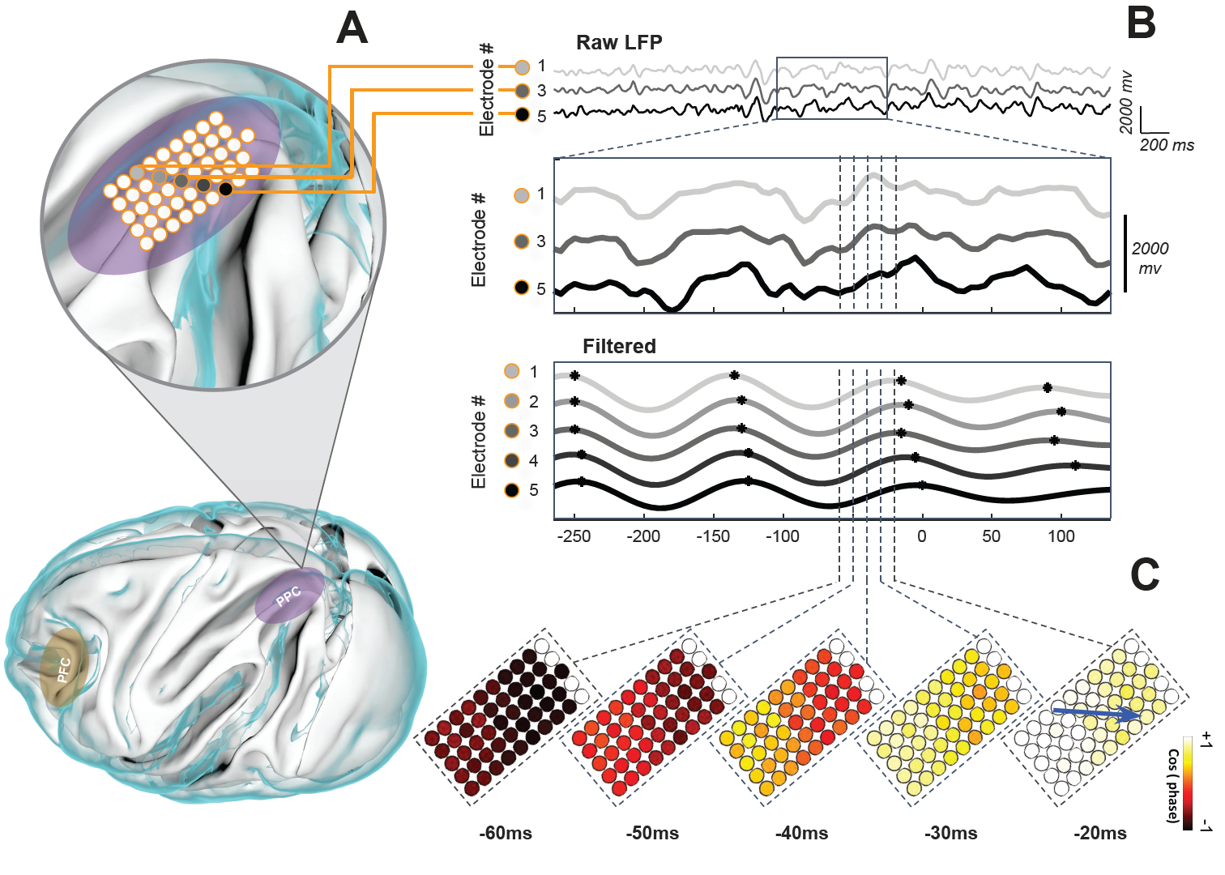
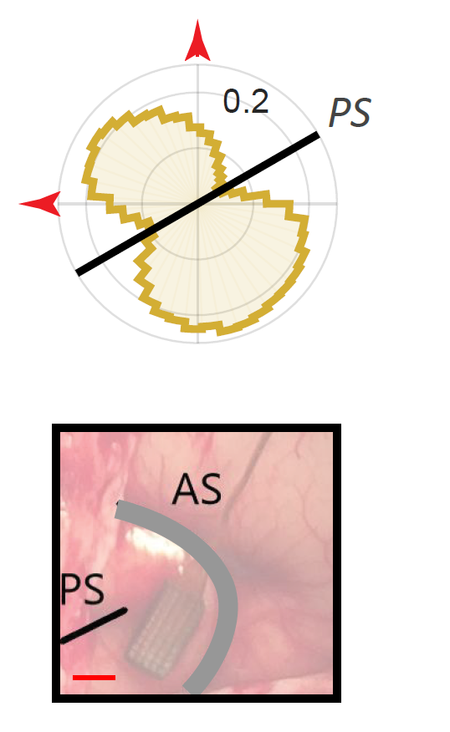
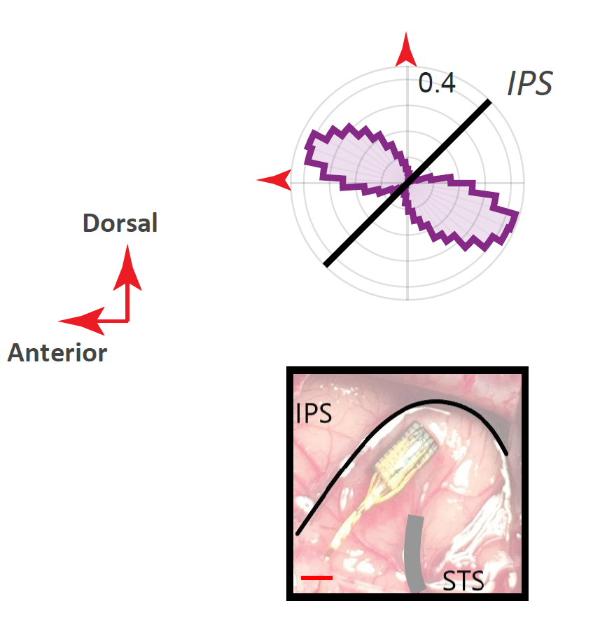
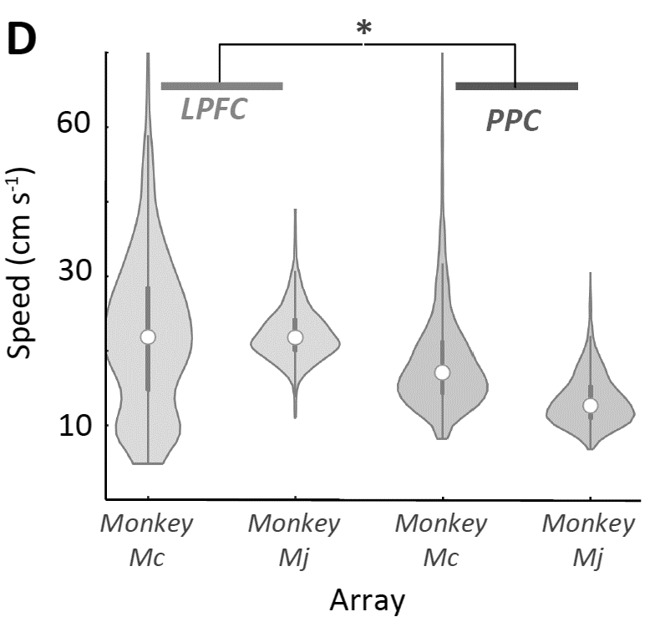

Frontoparietal LFPs are Traveling Waves
Physical properties of Traveling Waves
Wave Direction
Wave speed
Read More
LPFC
PPC
Zabeh et al. 2022
LPFC
PPC

Slide 2
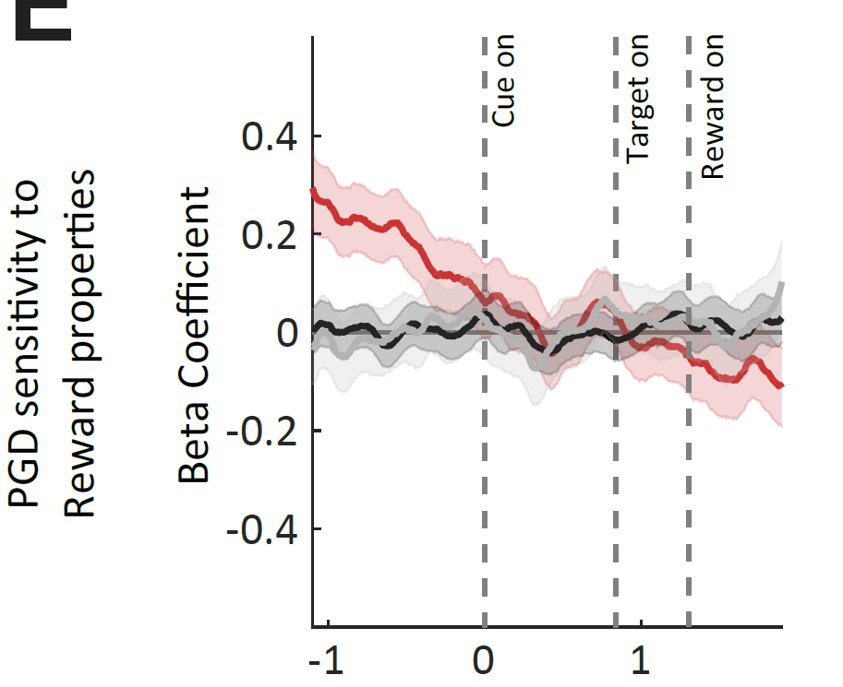
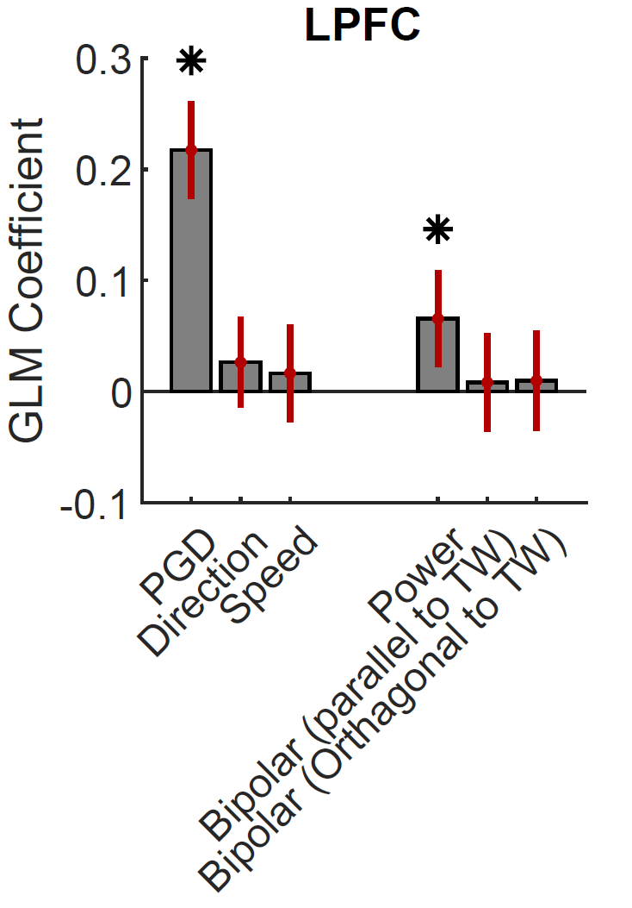
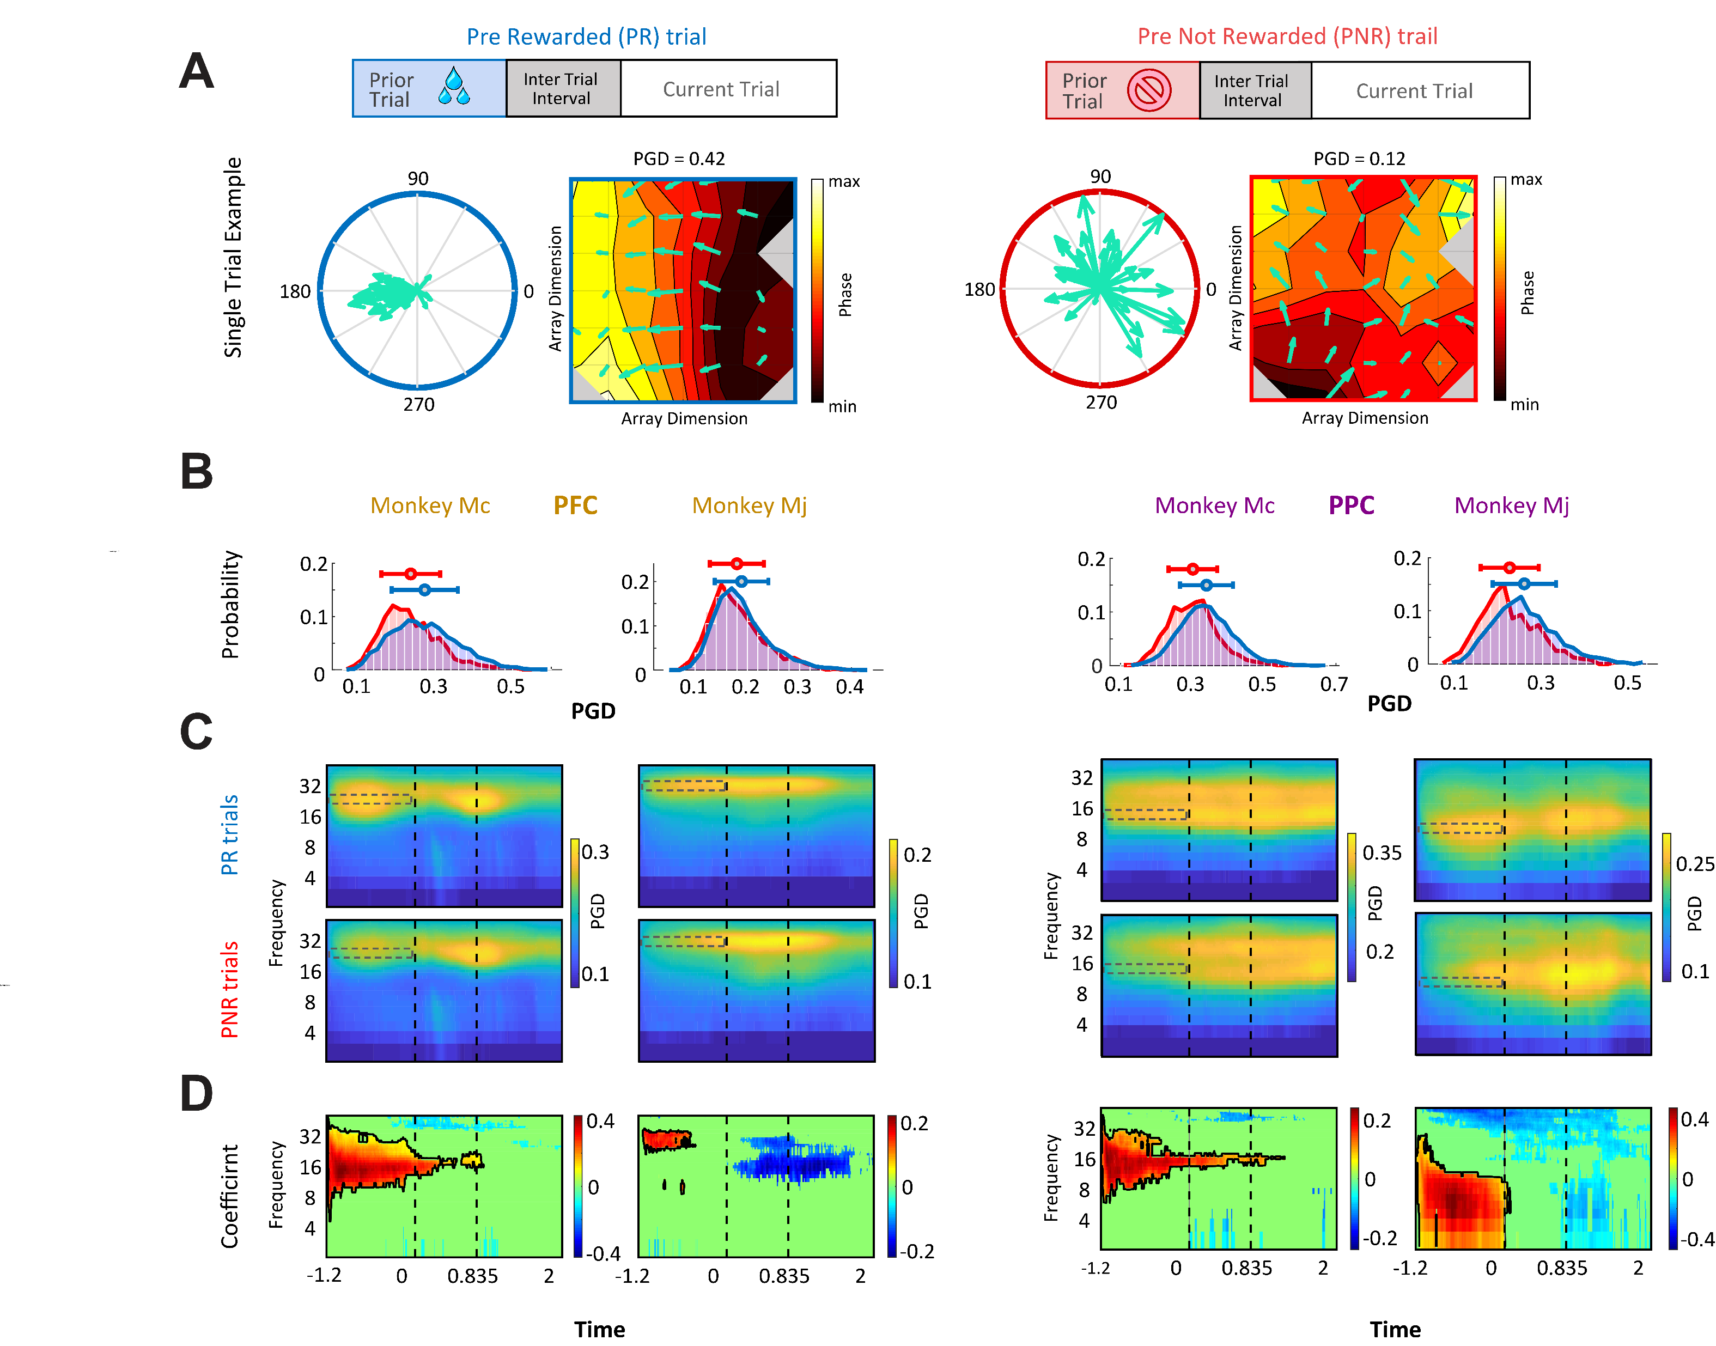
Behavioral Relevance
TW strength encode reward history PR
Exclusive to PR, not other reward mnemonics
Encoding is independent of other physiological markers
Read More
PR
Prior trial rewarded
PNR
Prior trial not rewarded
Zabeh et al. 2022
PR
EV
CR
PGD = 0.42
PGD = 0.12

Slide 3
